Slide 1
SCRAPING DATA FROM TWITTER
USING PYTHON
20671A0420
MOHAMMED FAYAZ

Slide 2
ABSTRACT
Twitter is a popular social networking website where users posts and interact with messages known as “tweets”.
This serves as a mean for individuals to express their thoughts or feelings about different subjects.
Various different parties such as consumers and marketers have done sentiment analysis on such tweets to gather insights into products or to conduct market analysis.
Further more, with the recent advancements in machine learning algorithms, we are able improve the accuracy of our sentiment analysis predictions.
The data provided comes with emoticons, usernames and hashtags which are required to be processed and converted into a standard form.
We also need to extract useful features from the text such unigrams and bigrams which is a form of representation of the “tweet”.

Slide 3
OBJECTIVE
Twitter is a major social networking service with over 200 million tweets made every day.
Twitter provides a list of Trending Topics in real time, but it is often hard to understand what these trending topics are about.
It is important and necessary to classify these topics into general categories with high accuracy for better information retrieval.

Slide 4
PROBLEM STATEMENT
The problem at hand consists of two subtasks:
  Phrase Level Sentiment Analysis in Twitter : Given a message containing a marked instance of a word or a phrase, determine whether that instance is positive, negative or neutral in that context.
  Sentence Level Sentiment Analysis in Twitter: Given a message, decide whether the message is positive, negative, or neutral sentiment. For messages conveying both a positive and negative sentiment, whichever is the stronger sentiment should be chosen

Slide 5
LIMITATIONS
No accuracy for text based classification
More Time consuming

Slide 6
EXISTING WORK
The biggest reason to adopt CNN in image analysis and classification is due to CNN can extract an area of features from global information, and it is able to consider the relationship among these features.
The above solution can achieve a higher accuracy in analysis and classification.
For natural language processing, texts data features also can be extracted piece by piece and to consider the relationship among these features, but without the consideration of context or whole sentence, the sentiment might be understood wrong.

Slide 7
PROPOSED WORK
The raw twitter data is given as input to the system. The unstructured input data can be obtained from various product and twitter data for and external sources Algorithms are SVM algorithm.
Proposed system analyzed several challenges at the data, model, and system levels. To support Big Data mining, high-performance computing platforms are required.
At the data level, the autonomous information sources and the variety of the data collection environments, often result in data with complicated conditions, such as missing/uncertain values.
In other situations, privacy concerns, noise, and errors can be introduced into the data, to produce altered data copies.

Slide 8
ADVANTAGE
More accurate
Less time consuming

Slide 9
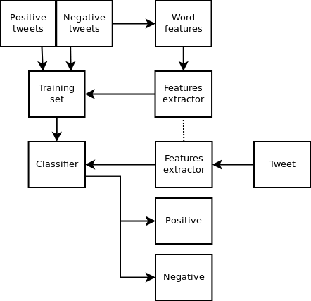
SYSTEM ARCHITECTURE

Slide 10
APPLICATIONS
Applications to Review-Related Websites:
  Movie reviews, product reviews etc.
Applications in Business and Government Intelligence:
  Knowing consumer attitudes and trends.
Applications across Different Domains:
  Knowing public opinions for political leaders or their notions about rules and regulations in place etc.

Slide 11
MODULES DESCRIPTION:-
Dataset collection
Data preprocessing
Feature extraction
Evaluation model

Slide 12
DATA PREPROCESSING:-
Data Preprocessing is a data mining technique used to transform the raw data into useful and efficient format. The data here goes through 2 stages.
1. Data Cleaning: It is very important for data to be error free and free of unwanted data. So, the data is cleansed before performing the next steps.
2. Data Transformation: Data Transformation is transformation of the datasets mathematically; data is transformed into appropriate forms suitable for data mining process.
This allows us to understand the data more keenly by arranging the 100‟s of records in an orderly way.

Slide 13
DATASET COLLECTION
Data ingestion is the transportation of data from assorted sources to a storage medium where it can be accessed, used, and analyzed by an organization.
The destination is typically a data warehouse, data mart, database, or a document store.
Sources may be almost anything – databases, spreadsheets, or even information scraped from the internet.
The data ingestion layer is the backbone of any analytics architecture.
There are different ways of ingesting data, and the design of a particular data ingestion layer can be based on various models or architectures.

Slide 14
FEATURE EXTRACTION:-
Correlation is a value between -1 and 1 that represents how closely values for two separate features move in unison.
Positive correlation means that as one feature increases, the other increases; Eg:a child's age and her height.
Negative correlation means that as one feature increases, the other decreases; Eg: Hours spent studying and number of parties attended.
Correlations near -1 or 1 indicate a strong relationship. Those closer to 0 indicate a weak relationship. 0 indicates no relationship.

Slide 15
REFERENCE
BOOKS: Web scraping with python,Second edition/ Authour:Ryan Mitchell,
A python guide for web scraping.

Slide 16
CONCLUSION:-
We analyse and compare the results and conclude that which algorithm is best suited for our problem statement and which algorithm giving us the best possibility results .
We get the output parameters such as accuracy level and plot the data in a matrix format which is called confusion matrix.

Slide 17
THANK YOU.

